Slide 1
Trees

Slide 2
Tree
Definition
A tree is a finite nonempty set of elements
It is an abstract model of a hierarchical structure.
consists of nodes with a parent-child relation.
Applications
Organization charts
File systems
Programming environments

Slide 3
Tree
Terminology
Root: node without parent (A)
Siblings: nodes share the same parent
Internal node: node with at least one child (A, B, C, F)
External node (leaf ): node without children (E, I, J, K, G, H, D)
Ancestors of a node: parent, grandparent, grand-grandparent, etc.
Descendant of a node: child, grandchild, grand-grandchild, etc.

Slide 4
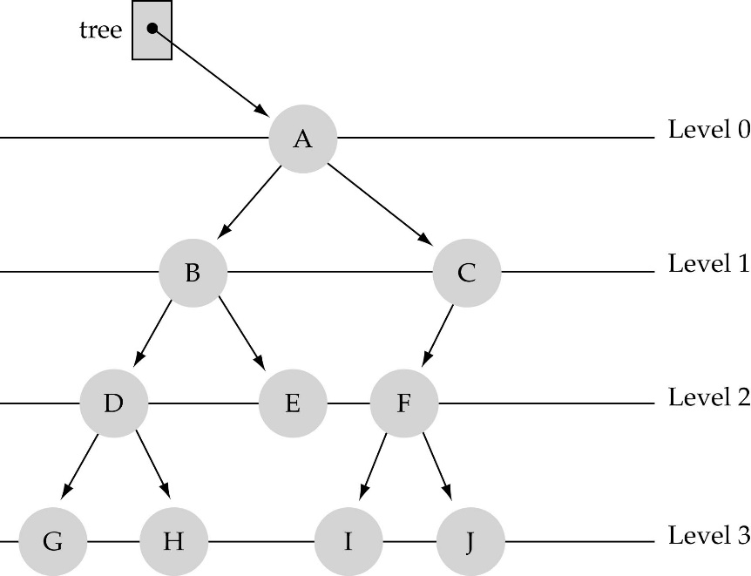
Tree
Terminology
Depth of a node:
number of ancestors or
its distance from the root
Height of a tree: maximum depth of any node (3)
Degree of a node: the number of its children
Degree of a tree: the maximum number of its node.
Subtree: tree consisting of a node and its descendants

Slide 5
Tree
Terminology
Subtree: tree consisting of a node and its descendants
A
subtree
B
C
D
E
F
G
H
I
J
K

Slide 6
Binary Trees

Slide 7
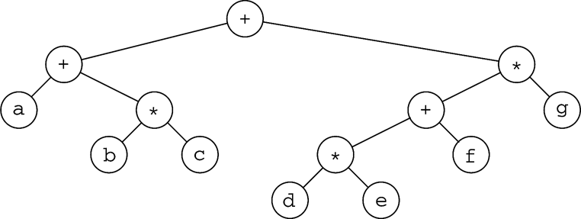
Binary Tree
Definition: A binary tree is a rooted tree in which no vertex has more than two children
root
1
2
3
4
5
6
7

Slide 8
Binary Tree
The root is drawn at the top
a
b
c
d
e
f
g
h
i
j
k
l

Slide 9
Binary Tree
Each node contains:
A value (some sort of data item)
A reference or pointer to a left child (may be null), and
A reference or pointer to a right child (may be null)
A binary tree may be empty (contain no nodes)
If not empty, a binary tree has a root node
Every node in the binary tree is reachable from the root node by a unique path

Slide 10
Binary Tree
size is 12
a is at depth zero
e is at depth 2
The depth of a binary tree is the depth of its deepest node
This tree has depth 4
a
b
c
d
e
f
g
h
i
j
k
l

Slide 11
Balance
A binary tree is balanced if every level above the lowest is “full” (contains 2^{n} nodes)
In most applications, a reasonably balanced binary tree is desirable
a
b
a
c
e
b
c
d
f
d
e
f
g
g
h
h
i
j
i
j
A balanced binary tree
An unbalanced binary tree

Slide 12
Tree traversals
A binary tree is defined recursively: it consists of a root, a left subtree, and a right subtree
To traverse (or walk) the binary tree is to visit each node in the binary tree exactly once
Tree traversals are naturally recursive
Inorder
Preorder
Postorder

Slide 13
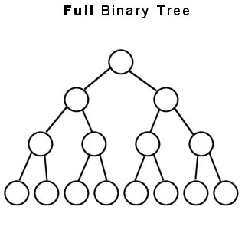
Full Tree
A full binary tree (sometimes proper binary tree or 2-tree) is a tree in which every node other than the leaves has two children

Slide 14
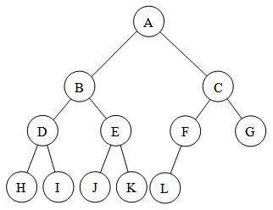
Complete Tree
A complete binary tree is a binary tree in which every level, except possibly the last, is completely filled, and all nodes are as far left as possible

Slide 15
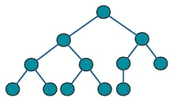
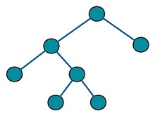
Complete Tree
A full but not complete binary tree

Slide 16
Binary search tree
A binary tree that has the following properties:
The left subtree of a node contains only nodes with data less than the node's data.
The right subtree of a node contains only nodes with data greater than the node's data.
Both the left and right subtrees are also binary search trees.

Slide 17
Binary search tree
Equal nodes can go either on the left or the right (but it has to be consistent)
10
8
15
4
12
20
17

Slide 18
Binary search tree
Consequences:
The smallest element in a binary search tree (BST) is the “left-most” node
The largest element in a BST is the “right-most” node
Inorder traversal of a BST encounters nodes in increasing order

Slide 19
Binary search tree
50
25
76
12
37
65
89
6
17
32
41
59
72
83
95

Slide 20
Tree traversal
The order in which the nodes are visited during a tree traversal can be easily determined by imagining there is a “flag” attached to each node, as follows:
preorder
inorder
postorder

Slide 21
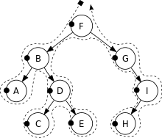
Preorder traversal
In preorder, the root is visited first
Check if the current node is empty / null
Display the data part of the root (or current node)
Traverse the left subtree by recursively calling the preorder function
Traverse the right subtree by recursively calling the preorder function
Pre-order: F, B, A, D, C, E, G, I, H.

Slide 22
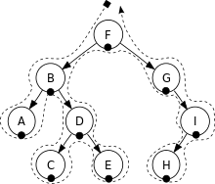
Inorder traversal
In a search tree, in-order traversal retrieves data in sorted order
Check if the current node is empty / null.
Traverse the left subtree by recursively calling the in-order function.
Display the data part of the root (or current node).
Traverse the right subtree by recursively calling the in-order function
In-order: A, B, C, D, E, F, G, H, I

Slide 23

Postorder traversal
Check if the current node is empty / null.
Traverse the left subtree by recursively calling the post-order function.
Traverse the right subtree by recursively calling the post-order function.
Display the data part of the root (or current node)
In-order: A, C, E, D, B, H, I, G, F

Slide 24

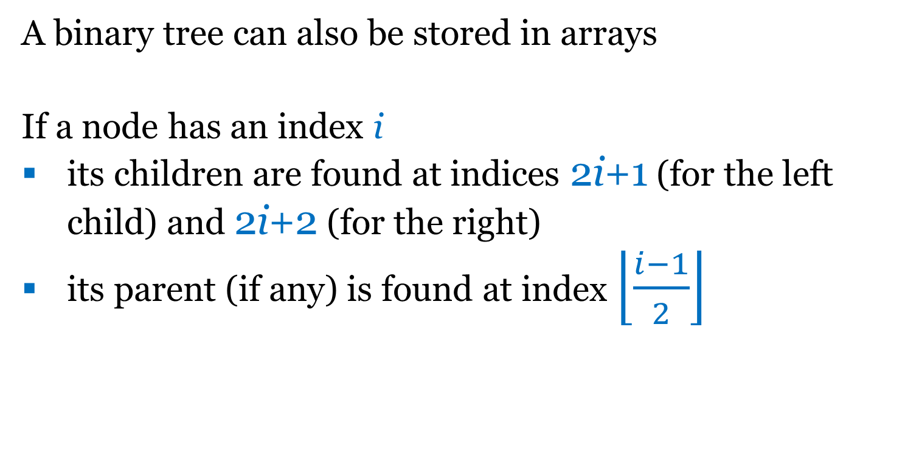
Binary search tree
A binary tree can also be stored in arrays
If a node has an index i
its children are found at indices 2i+1 (for the left child) and 2i+2 (for the right)
its parent (if any) is found at index $\left\lfloor \frac{i−1}{2}\right\rfloor$

